Slide 1
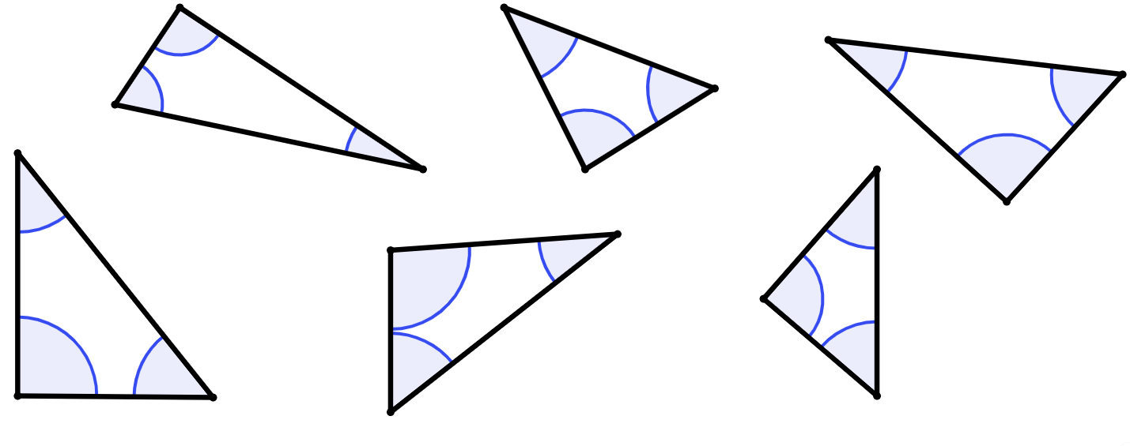


Determining which side
Determining which side
Task A: Identifying the hypotenuse
1) Complete each statement.
a) Pythagoras’ theorem can only be used to calculate the length of a missing side of a triangle if one of its sides is a ____________.
b) Only ________________ triangles have a hypotenuse.
c) The hypotenuse is always opposite the ________________.
hypotenuse
right-angled
right angle
2) Write a sentence to explain why Pythagoras’ theorem cannot be used to find the value k.
39 cm
44°
k cm
The missing angle is 89°, and therefore this triangle is not right-angled.
You cannot use Pythagoras’ theorem on triangles that are not right-angled.
47°
37 cm
3) For each of these triangles, tick (✔) each right-angled triangle, cross (✘) non-right-angled triangle, put a question mark (?) by each one where you cannot tell.
For each right-angled triangle, circle or highlight its hypotenuse.
a)
b)
c)
68°
52°
d)
22°
?
92°
39°
e)
41°
34°
f)
51°
52°
50°

Slide 2
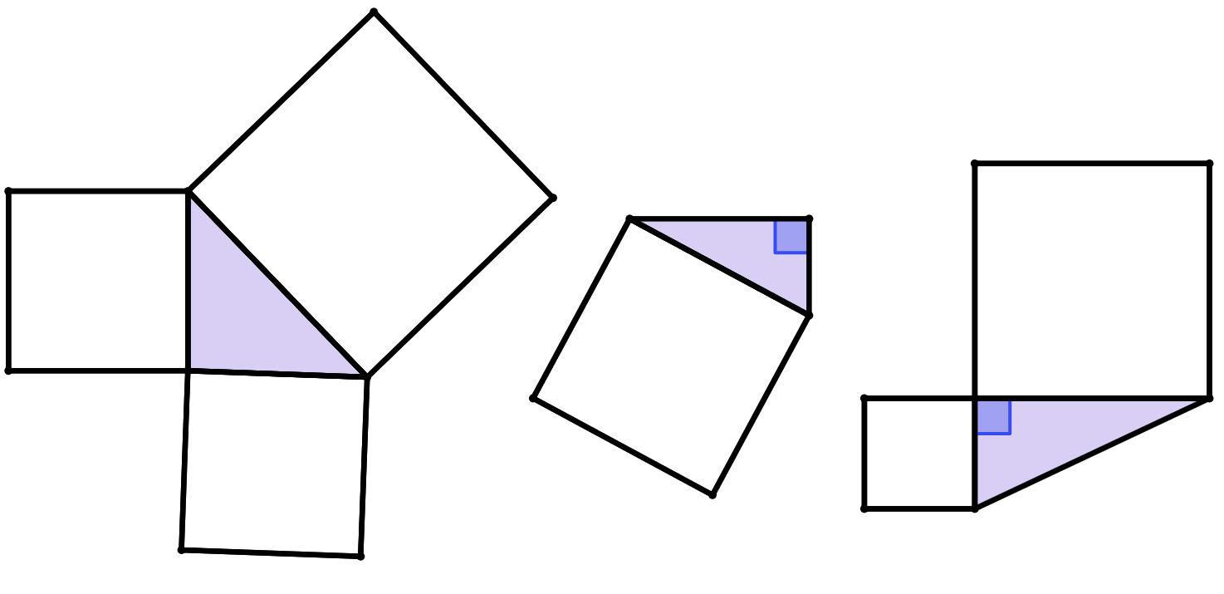

Determining which side
4) For which of these triangles can you use Pythagoras’ theorem?
Where possible, calculate the length of the hypotenuse and label its length.
a)
area
350 cm²
b)
c)
area
169 cm²
hypotenuse
87 cm
area
1201 cm²
area
171 cm²
area
7569 cm²
area
648 cm²
hypotenuse
43 cm
Task B: Right-angled triangles and congruence
1) x represents the length of the missing side on one of these two triangles.
Match these calculations created from the Pythagoras’ theorem formula to the correct triangle.
23² + 9² = x²
a
b
23² + x² = 9²
triangle A | triangle B | neither triangle
c
x² + 9² = 23²
b
g
d
9² + 23² = x²
23 cm
23 cm
e
9² + x² = 23²
f
x² = 23² – 9²
9 cm
9 cm
g
x² = 9² – 23²
a
d
c
e
f

Slide 3
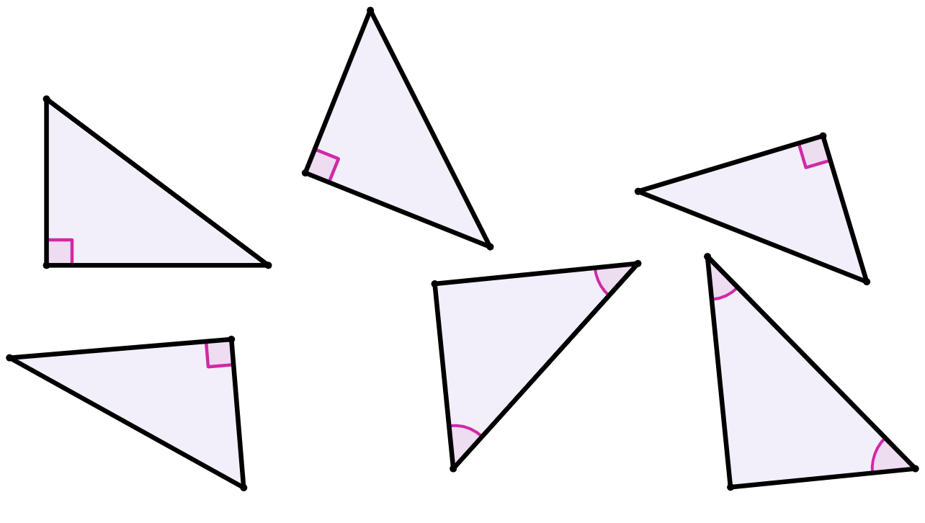
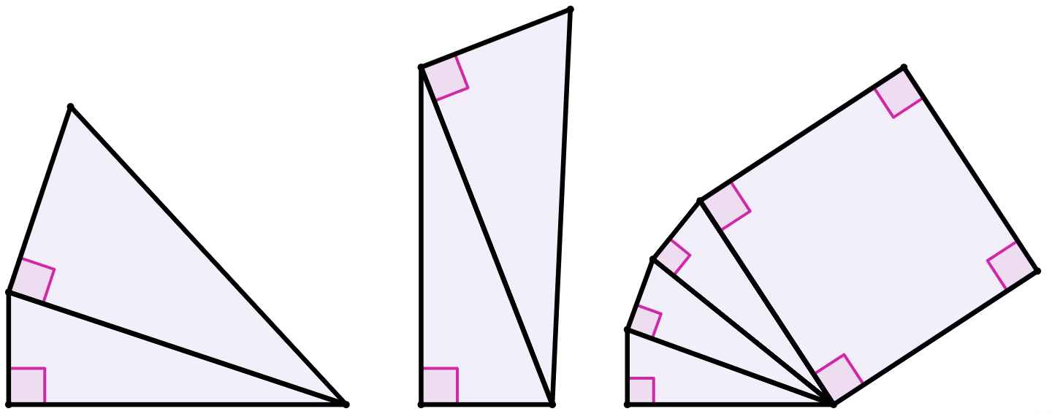
Determining which side
Task C: Finding the length of missing sides
1) Match the triangle to the length of its missing side.
16 cm
g
21.26 cm
i
13 cm
h
25.46 cm
18 cm
a)
20 cm
c)
b)
g
14 cm
i
30 cm
24 cm
k
39°
j
49.64 cm
22 cm
42°
58 cm
k
15.20 cm
31.5 cm
e)
l
32.56 cm
24 cm
j
f)
d)
h
40.5 cm
l
51°
48°
30 cm
2) Which of these triangles are congruent to triangle X?
63 cm
63 cm
63 cm
c)
a)
b)
16 cm
65 cm
16 cm
16 cm
16 cm
triangle X
f)
63 cm
67 cm
d)
e)
16 cm
65 cm
g)
16 cm
65 cm
63 cm
65 cm
3) Calculate the length of each unknown side labelled with a letter, rounding your answer to 2 decimal places.
18 cm
a cm = 32.39 cm
56 cm
c cm = 5 cm
50 cm
18 cm
a cm
area of square
28 cm²
1 cm
1 cm
10 cm
b cm = 17.66 cm
1 cm
25 cm
b cm
c cm
Mathematics in Education and Industry.
v2.3

